Slide 1
Samba Server

Slide 2

Samba in CentOS 7

Slide 3

Table of Contents
1. Introduction to Samba Server
2. Why Samba server?
3. Implementing Samba on CentOS 7
4. Accessing from windows
5. Conclusion

Slide 4
Samba Sever
Introduction
A Samba file server enables file sharing across different operating systems over a network. It lets you access your desktop files from a laptop and share files with Windows and macOS users. It also uses the Server Message Block and Common Internet File System (SMB/CIFS) protocol, so the services created by running Samba are available to Linux, macOS, and Windows clients. It's an essential service to run in organizations that support multiple operating systems, and it's even useful on homogenous networks.

Slide 5
Key Features
Introduction (cont.)
Key features of Samba include:
Samba provides authentication services, allowing users to access shared resources with appropriate permissions.
It supports various authentication methods, including user-based authentication and domain authentication.
Samba has become a standard component of many Linux distributions and is widely used in both home and enterprise environments
It's not difficult to set up, and all you need is at least one server you want to designate as a file-share host.

Slide 6
Why Samba server?
Advantages:
Samba provides interoperability with Windows networking protocols, allowing CentOS 7 servers to integrate smoothly into Windows-based networks.
Samba allows for seamless file and resource sharing between systems running different operating systems, such as Windows, Linux, and Unix.
Samba is highly configurable and allows administrators to customize settings based on their specific requirements.

Slide 7

IMPLEMENTING SAMBA IN CENTOS 7
Installing Samba in CentOS 7
Prerequisites For Installing Samba on CentOS includes:
Samba works with all popular Linux/Unix-based OS, such as Ubuntu, CentOS, and Red Hat Enterprise Linux.
You need to make sure that Samba is whitelisted and that the firewall allows the traffic through ports allocated to Samba.
You might need to create user accounts For Samba.
On CentOS, YUM is a great option for managing packages and handling installation.
We’ll use the following command to install the Samba server, client, and related files.

Slide 8
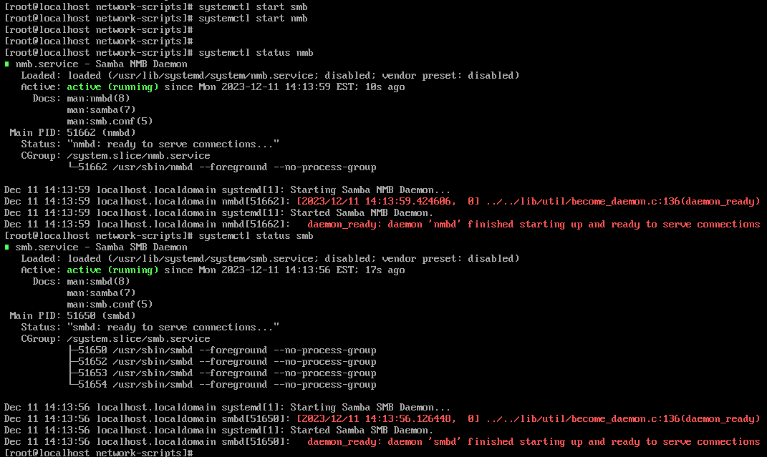
IMPLEMENTING SAMBA IN CENTOS 7 (cont.)
Enabling and starting the services:

Slide 9
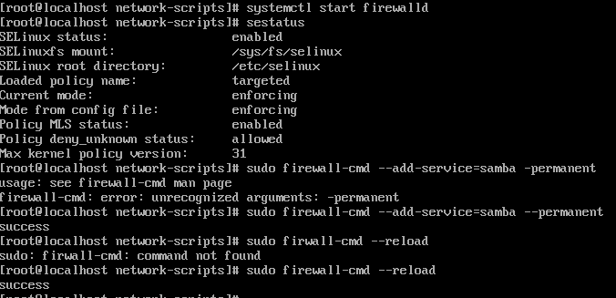
IMPLEMENTING SAMBA IN CENTOS 7 (cont.)
Enabling firewall in CentOS 7

Slide 10


IMPLEMENTING SAMBA IN CENTOS 7 (cont.)
Creating User and group in CentOS 7

Slide 11
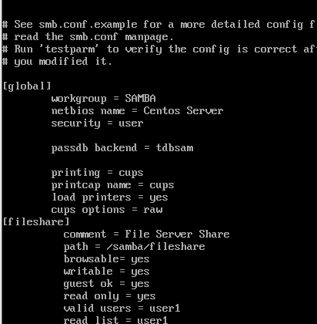

Implementing Samba in CentOS 7? (cont.)
Server-side configuration in CentOS 7

Slide 12

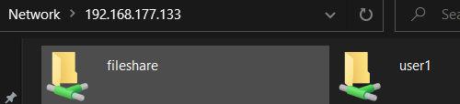
ACCESSING FROM WINDOWS
Accessing folders
Accessing files

Slide 13

Conclusion
In conclusion, deploying a Samba server on CentOS 7 enhances file-sharing capabilities across diverse operating systems, fostering seamless collaboration within a network.
Samba is a flexible networking protocol connecting Linux, Windows, and macOS machines. Samba is used to allow printer sharing between Windows and Linux systems. A Linux server can be added to a Windows network by setting it up as an Active Directory Domain Controller. If you want to exchange data between Windows and Linux systems, Samba is a viable option because it is simple to set up and use.

Slide 14
Thank You

